Slide 1


Community Analysis
SOCIAL
MEDIA
MINING

Slide 2
Dear instructors/users of these slides: Please feel free to include these slides in your own material, or modify them as you see fit. If you decide to incorporate these slides into your presentations, please include the following note:
R. Zafarani, M. A. Abbasi, and H. Liu, Social Media Mining: An Introduction, Cambridge University Press, 2014.
Free book and slides at http://socialmediamining.info/
or include a link to the website: http://socialmediamining.info/

Slide 3

Social Community
[real-world] community
A group of individuals with common economic, social, or political interests or characteristics, often living in relative proximity.
Notes:
Community is “a group of densely interconnected nodes”
Ref: Y.-Y. Ahn, J. P. Bagrow, and S. Lehmann, "Communities and Hierarchical Organization of Links in Complex Networks", submitted, arxiv:0903.3178.
Community is “a group of TOPOLOGICALLY SIMILAR LINKS”
Ref: Y.-Y. Ahn, J. P. Bagrow, and S. Lehmann, "Communities and Hierarchical Organization of Links in Complex Networks", submitted, arxiv:0903.3178.

Slide 4
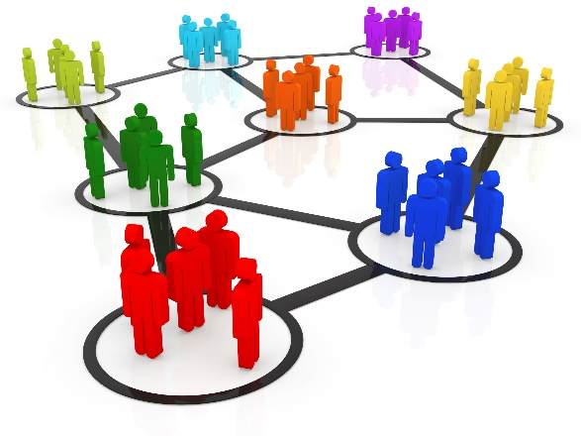
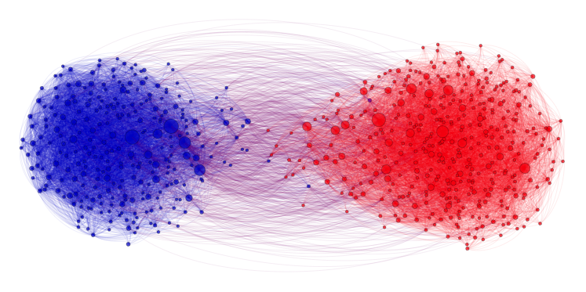
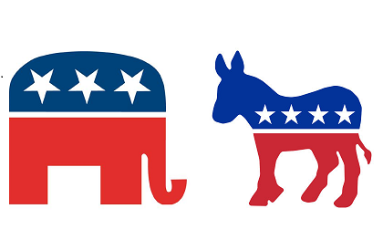
Why analyze communities?
Analyzing communities helps better understand users
Users form groups based on their interests
Groups provide a clear global view of user interactions
E.g., find polarization
Some behaviors are only observable in a group setting and not on an individual level
Some republican can agree with some democrats, but their parties can disagree
Notes:
Explicitly vs. implicitly formed groups

Slide 5
Social Media Communities
Formation:
When like-minded users on social media form a link and start interacting with each other
More Formal Formation:
A set of at least two nodes sharing some interest, and
Interactions with respect to that interest.
Social Media Communities
Explicit (emic): formed by user subscriptions
Implicit (etic): implicitly formed by social interactions
Example: individuals calling Canada from the United States
Phone operator considers them one community for promotional offers
Other community names: group, cluster, cohesive subgroup, or module
Notes:
Explicitly vs. implicitly formed groups

Slide 6




Examples of Explicit Social Media Communities
Facebook has groups and communities. Users can
post messages and images,
can comment on other messages,
can like posts, and
can view activities of other users
In Google+, Circles represent communities
In Twitter, communities form as lists.
Users join lists to receive information in the form of tweets
LinkedIn provides Groups and Associations.
Users can join professional groups where they can post and share information related to the group

Slide 7
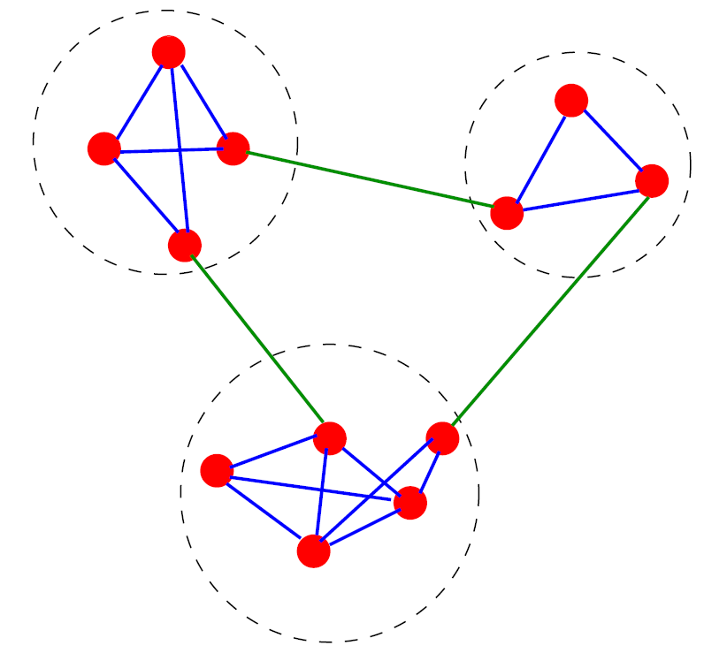
Finding Implicit Communities: An Example
A simple graph in which three implicit communities are found, enclosed by the dashed circles

Slide 8
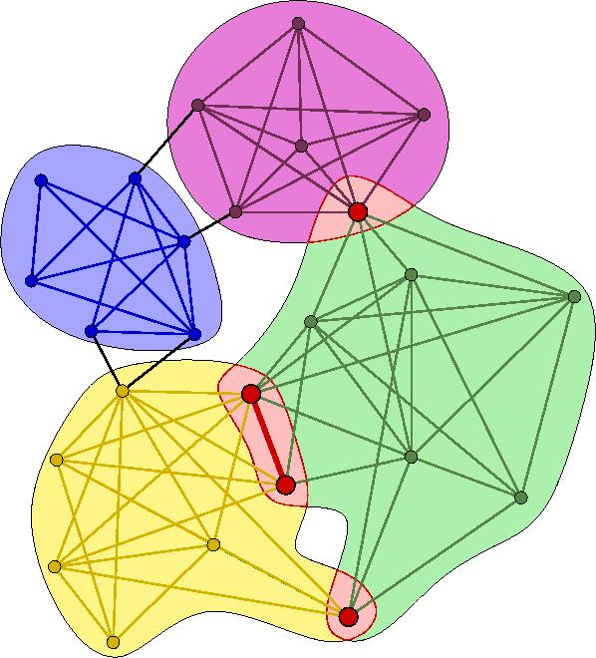
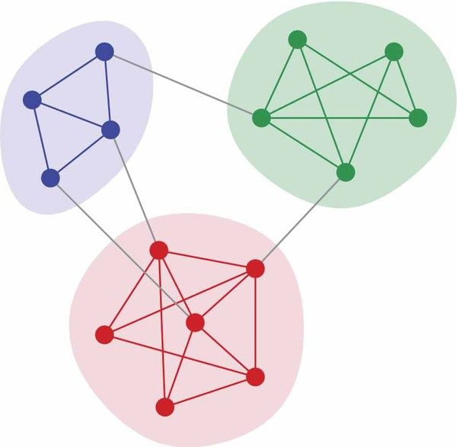
Overlapping vs. Disjoint Communities
Overlapping Communities
Disjoint Communities

Slide 9
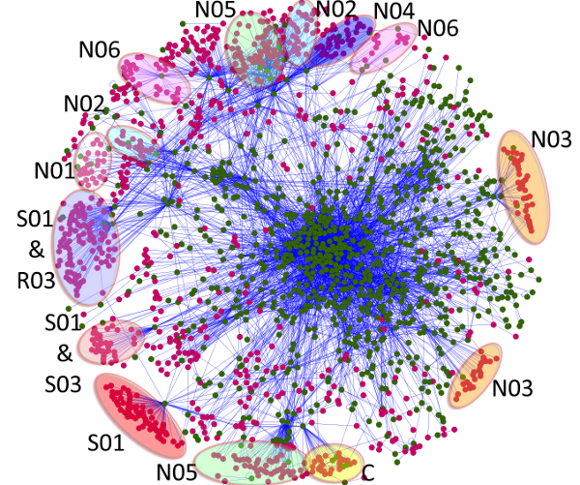
Implicit communities in other domains
Protein-protein interaction networks
Communities are likely to group proteins having the same specific function within the cell
World Wide Web
Communities may correspond to groups of pages dealing with the same or related topics
Metabolic networks
Communities may be related to functional modules such as cycles and pathways
Food webs
Communities may identify compartments

Slide 10
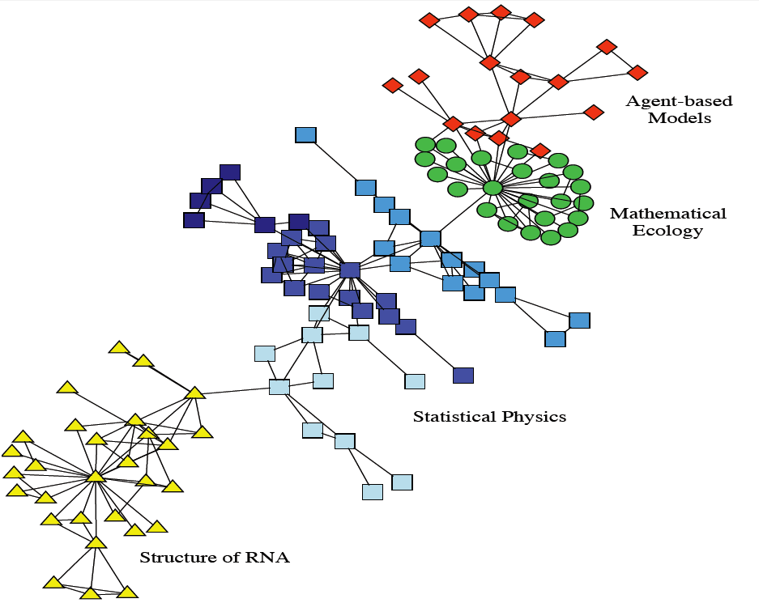
Real-world Implicit Communities
Collaboration network between scientists working at the Santa Fe Institute.
The colors indicate high level communities and correspond to research divisions of the institute

Slide 11
What is Community Analysis?
Community detection
Discovering implicit communities
Community evolution
Studying temporal evolution of communities
Community evaluation
Evaluating Detected Communities

Slide 12
Community Detection

Slide 13
What is community detection?
The process of finding clusters of nodes (‘‘communities’’)
With Strong internal connections and
Weak connections between different communities
Ideal decomposition of a large graph
Completely disjoint communities
There are no interactions between different communities.
In practice,
find community partitions that are maximally decoupled.

Slide 14
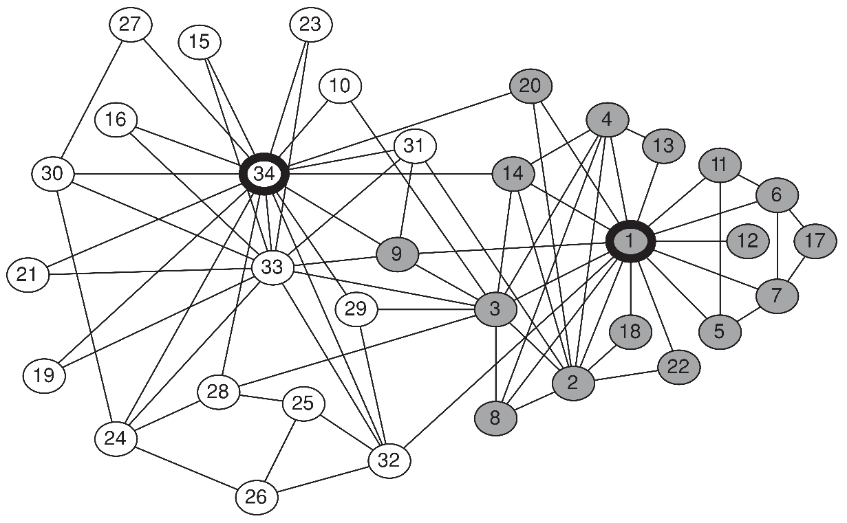
Why Detecting Communities is Important?
Zachary's karate club
Interactions between 34 members of a karate club
for over two years
The club members split into two groups (gray and white)
Disagreement between the administrator of the club (node 34) and the club’s instructor (node 1),
The members of one group left to start their own club
The same communities can be found using community detection

Slide 15
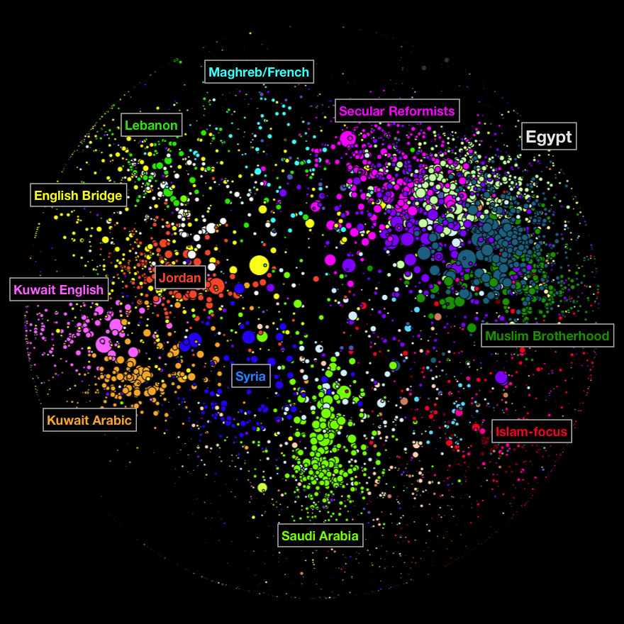
Why Community Detection?
Network Summarization
A community can be considered as a summary of the whole network
Easier to visualize and understand
Preserve Privacy
[Sometimes] a community can reveal some properties without releasing the individuals’ privacy information.

Slide 16
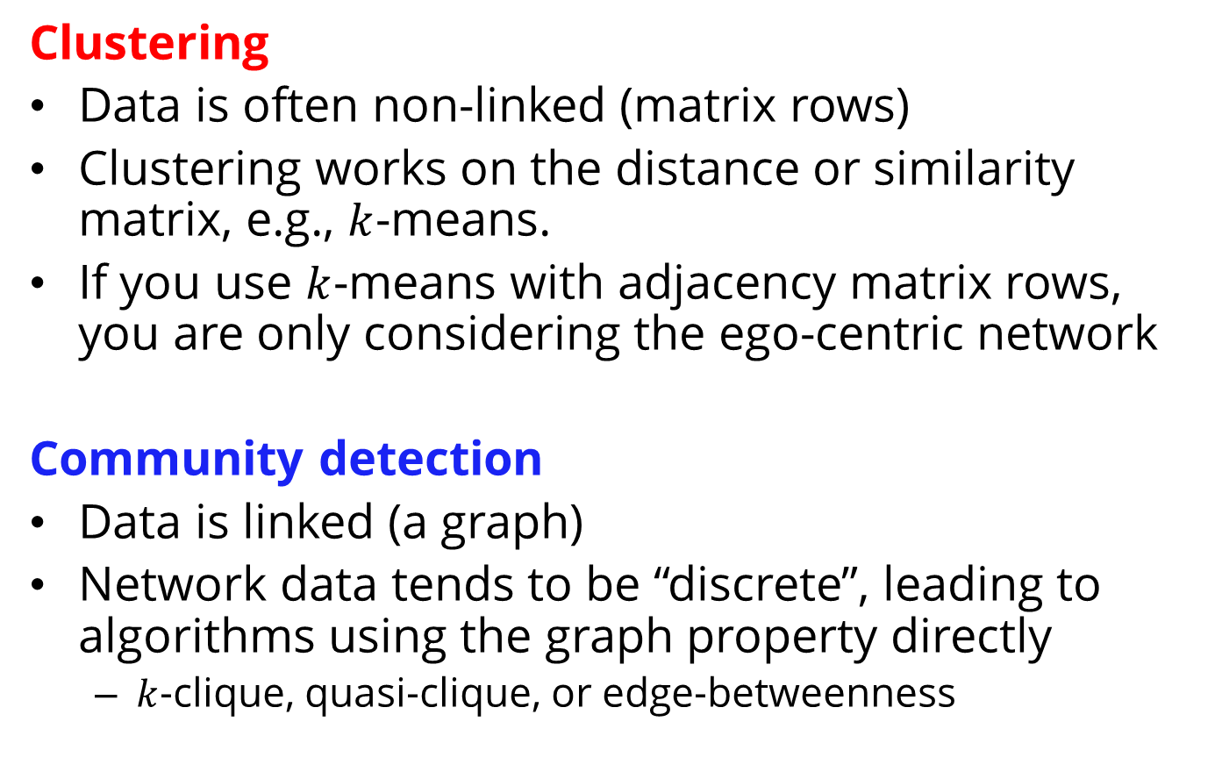
Community Detection vs. Clustering
Clustering
Data is often non-linked (matrix rows)
Clustering works on the distance or similarity matrix, e.g., $k$-means.
If you use $k$-means with adjacency matrix rows, you are only considering the ego-centric network
Community detection
Data is linked (a graph)
Network data tends to be “discrete”, leading to algorithms using the graph property directly
$k$-clique, quasi-clique, or edge-betweenness
Notes:
From Lei’s Slides

Slide 17
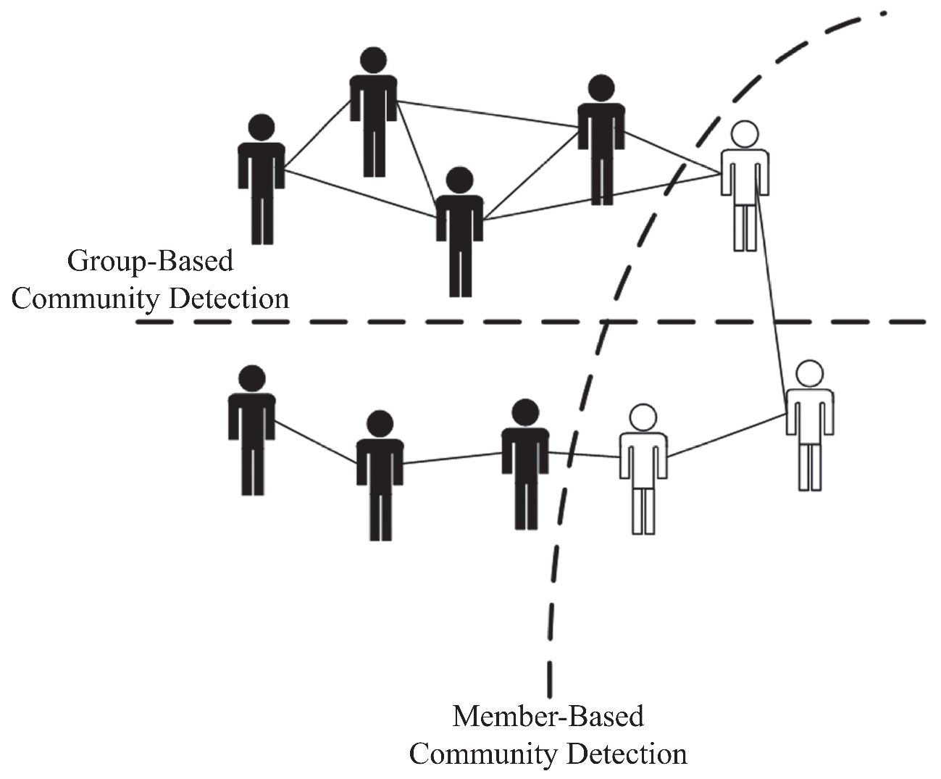
Community Detection Algorithms
Group Users based on Group attributes
Group Users based on Member
attributes

Slide 18
Member-Based Community Detection

Slide 19
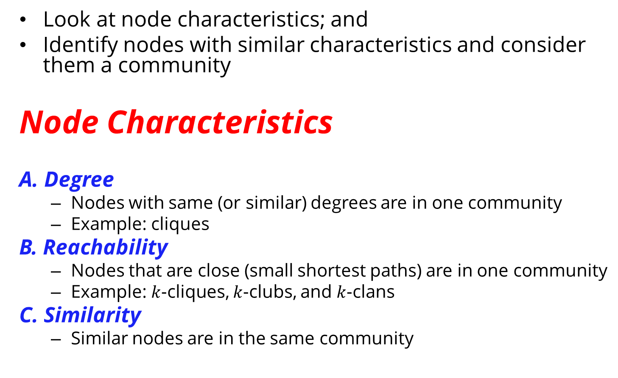
Member-Based Community Detection
Look at node characteristics; and
Identify nodes with similar characteristics and consider them a community
Node Characteristics
A. Degree
Nodes with same (or similar) degrees are in one community
Example: cliques
B. Reachability
Nodes that are close (small shortest paths) are in one community
Example: $k$-cliques, $k$-clubs, and $k$-clans
C. Similarity
Similar nodes are in the same community

Slide 20
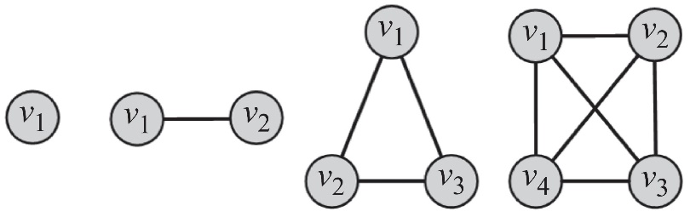
A. Node Degree
Most common subgraph searched for:
Clique: a maximum complete subgraph in which all nodes inside the subgraph adjacent to each other
Find communities by searching for
The maximum clique: the one with the largest number of vertices, or
All maximal cliques: cliques that are not subgraphs of a larger clique; i.e., cannot be further expanded
To overcome this, we can
Brute Force
Relax cliques
Use cliques as the core for larger communities
Both problems are NP-hard

Slide 21
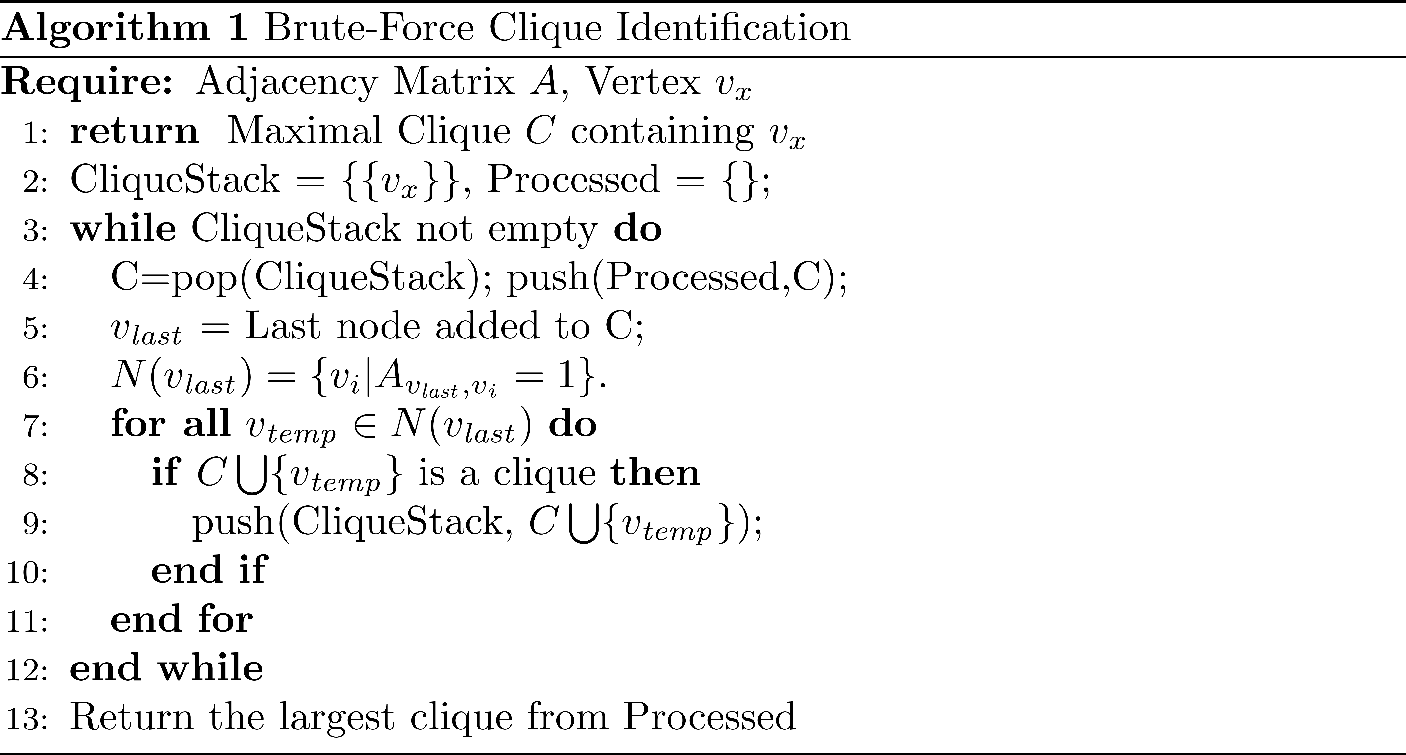
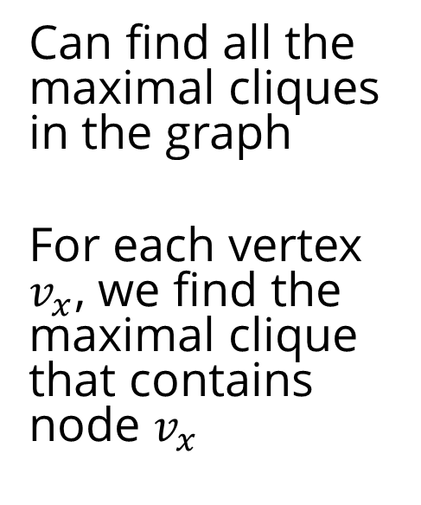
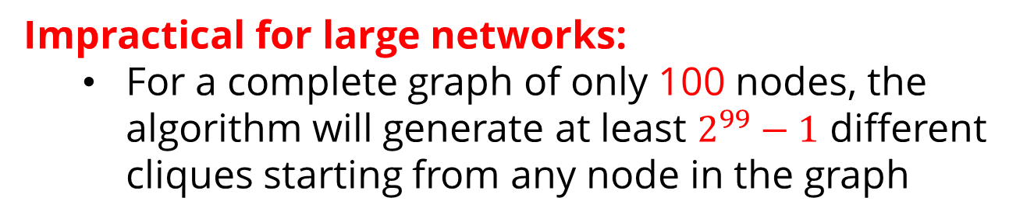
I. Brute-Force Method
Can find all the maximal cliques in the graph
For each vertex $v_{x}$, we find the maximal clique that contains node $v_{x}$
Impractical for large networks:
For a complete graph of only 100 nodes, the algorithm will generate at least $2^{99}−1$ different cliques starting from any node in the graph

Slide 22
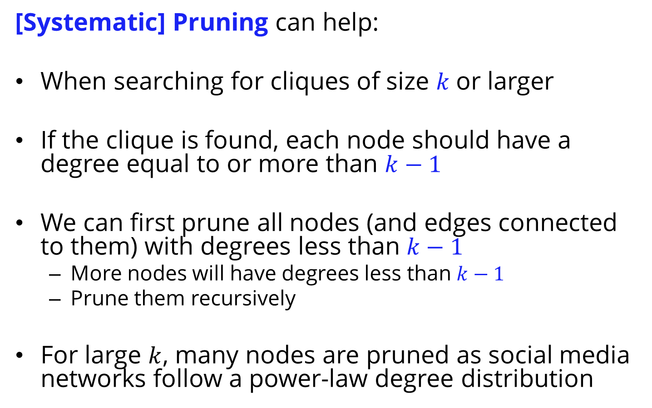
Enhancing the Brute-Force Performance
[Systematic] Pruning can help:
When searching for cliques of size $k$or larger
If the clique is found, each node should have a degree equal to or more than $k−1$
We can first prune all nodes (and edges connected to them) with degrees less than $k−1$
More nodes will have degrees less than $k−1$
Prune them recursively
For large $k$, many nodes are pruned as social media networks follow a power-law degree distribution

Slide 23
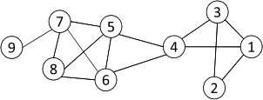
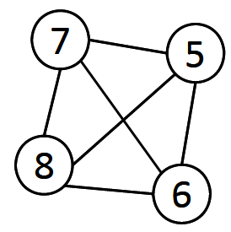
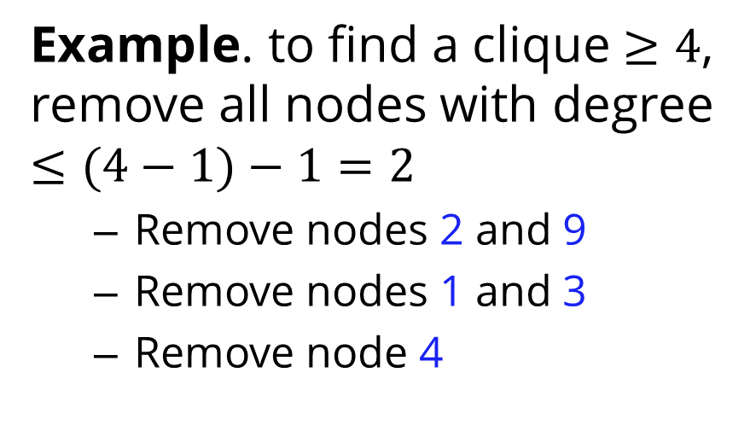
Maximum Clique: Pruning…
Example. to find a clique $≥4$, remove all nodes with degree $≤(4−1)−1=2$
Remove nodes 2 and 9
Remove nodes 1 and 3
Remove node 4
Even with pruning, cliques are less desirable
Cliques are rare
A clique of 1000 nodes, has 999x1000/2 edges
A single edge removal destroys the clique
That is less than 0.0002% of the edges!

Slide 24
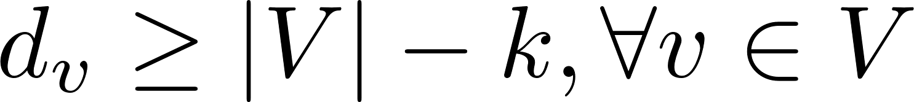
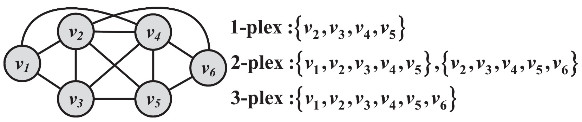
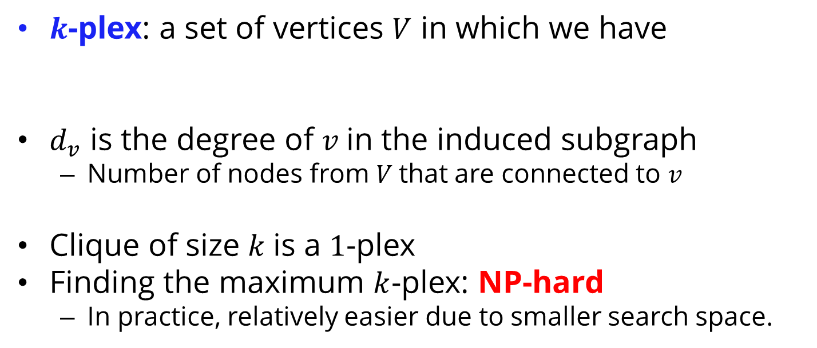
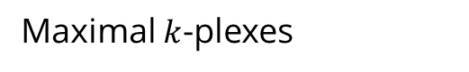
II. Relaxing Cliques
$k$-plex: a set of vertices $V$ in which we have
$d_{v}$ is the degree of $v$in the induced subgraph
Number of nodes from $V$that are connected to $v$
Clique of size $k$is a $1$-plex
Finding the maximum $k$-plex: NP-hard
In practice, relatively easier due to smaller search space.
Maximal $k$-plexes

Slide 25

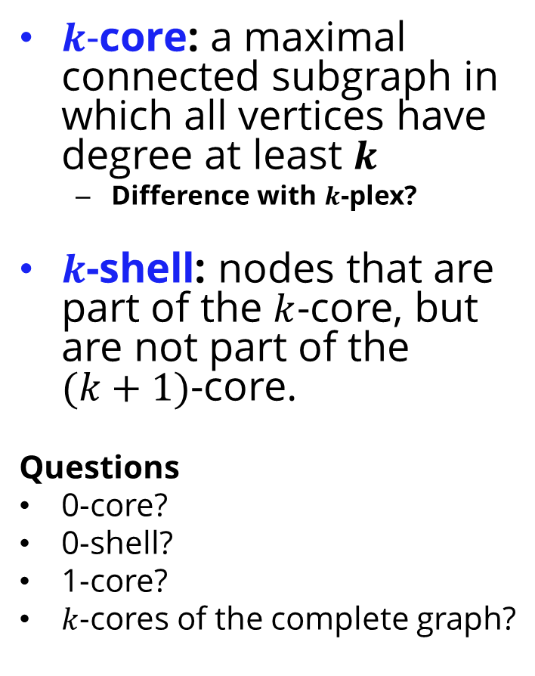
More Cliques Relaxing…
$k$-core: a maximal connected subgraph in which all vertices have degree at least $k$
Difference with $k$-plex?
$k$-shell: nodes that are part of the $k$-core, but are not part of the $(k+1)$-core.
Questions
0-core?
0-shell?
1-core?
$k$-cores of the complete graph?
A Clique that wants to relax
A 2-plex or a 2-core?

Slide 26
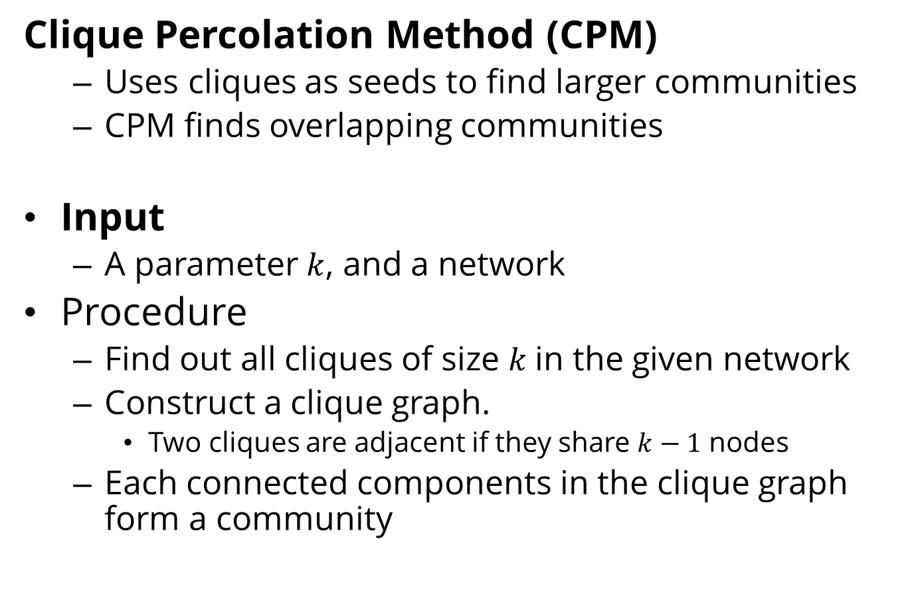
III. Using Cliques as a seed of a Community
Clique Percolation Method (CPM)
Uses cliques as seeds to find larger communities
CPM finds overlapping communities
Input
A parameter $k$, and a network
Procedure
Find out all cliques of size $k$in the given network
Construct a clique graph.
Two cliques are adjacent if they share $k−1$ nodes
Each connected components in the clique graph form a community

Slide 27
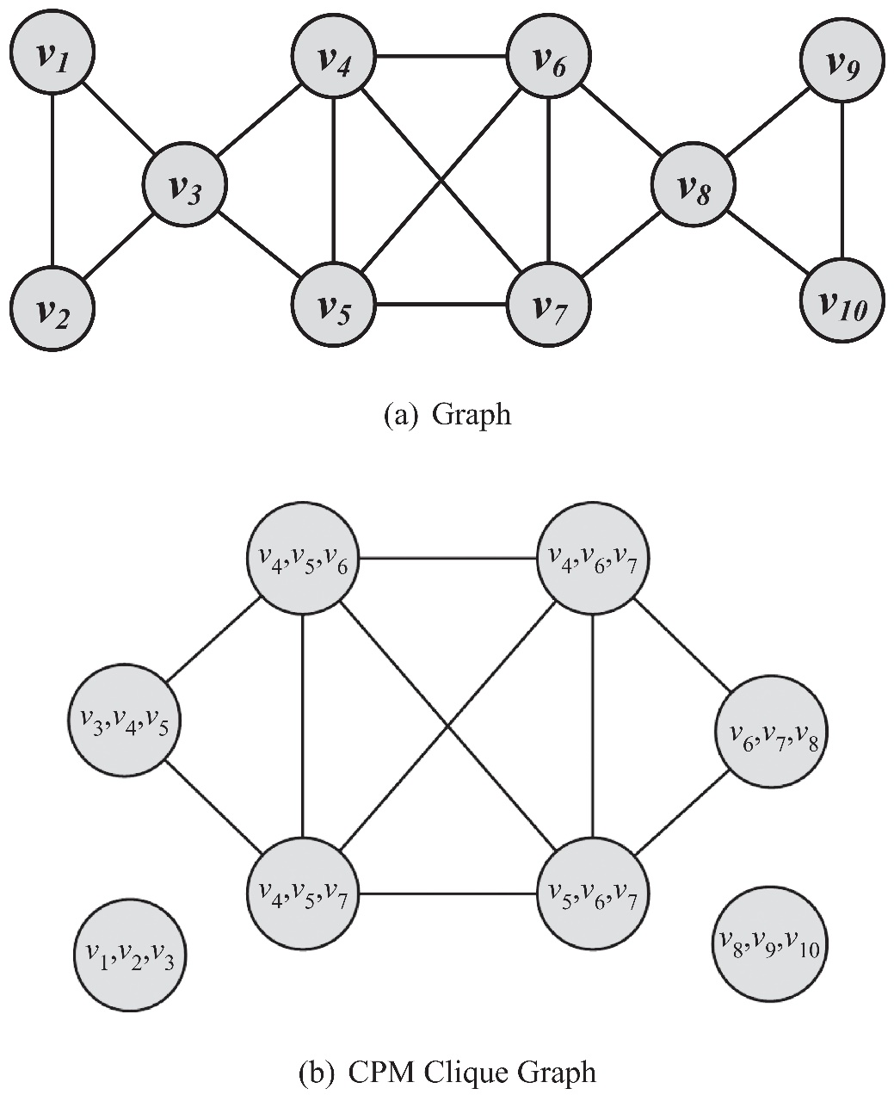
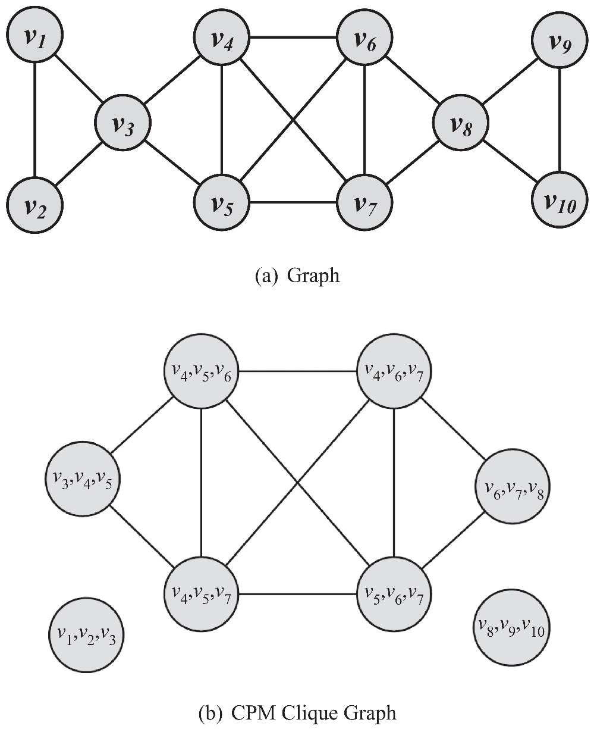
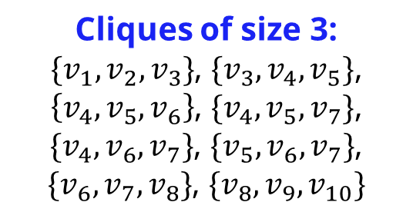
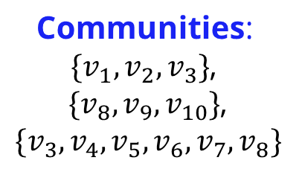
Clique Percolation Method: Example
Cliques of size 3:
$\{v_{1},v_{2},v_{3}\}$, $\{v_{3},v_{4},v_{5}\}$,
$\left\{v_{4},v_{5},v_{6}\right\}$, $\{v_{4},v_{5},v_{7}\}$, $\{v_{4},v_{6},v_{7}\}$, $\{v_{5},v_{6},v_{7}\}$,
$\{v_{6},v_{7},v_{8}\}$, $\{v_{8},v_{9},v_{10}\}$
Communities:
$\{v_{1},v_{2},v_{3}\}$,
$\{v_{8},v_{9},v_{10}\}$,
$$\{v_{3},v_{4},v_{5},v_{6},v_{7},v_{8}\}$$

Slide 28
B. Node Reachability
The two extremes
Nodes are assumed to be in the same community
If there is a path between them (regardless of the distance) or
They are so close as to be immediate neighbors.
How? Find using BFS/DFS
Challenge: most nodes are in one community (giant component)
How? Finding Cliques
Challenge: Cliques are challenging to find and are rarely observed
Solution: find communities that are in between cliques and connected components in terms of connectivity and have small shortest paths between their nodes

Slide 29
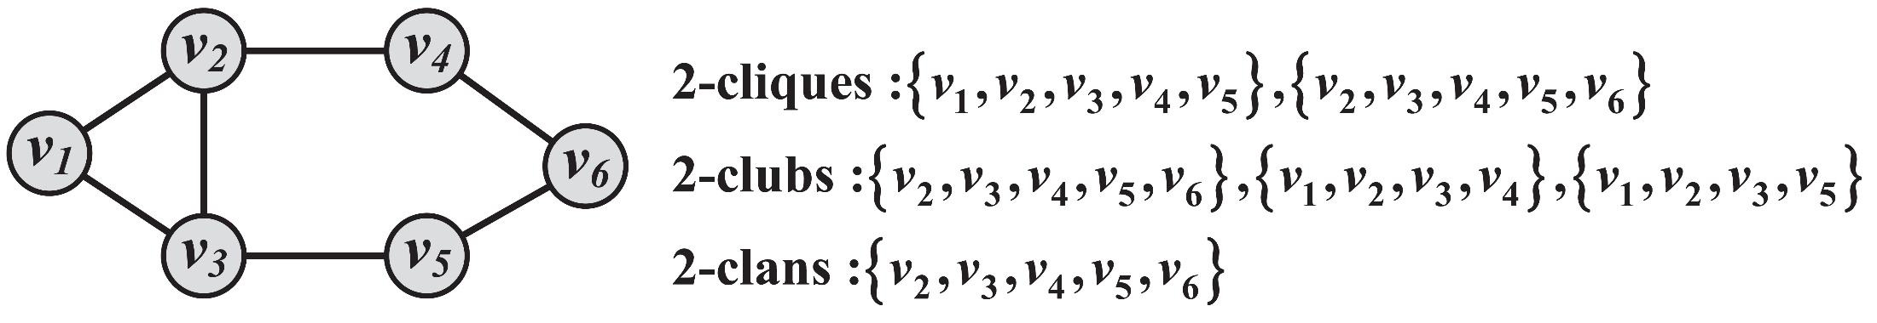
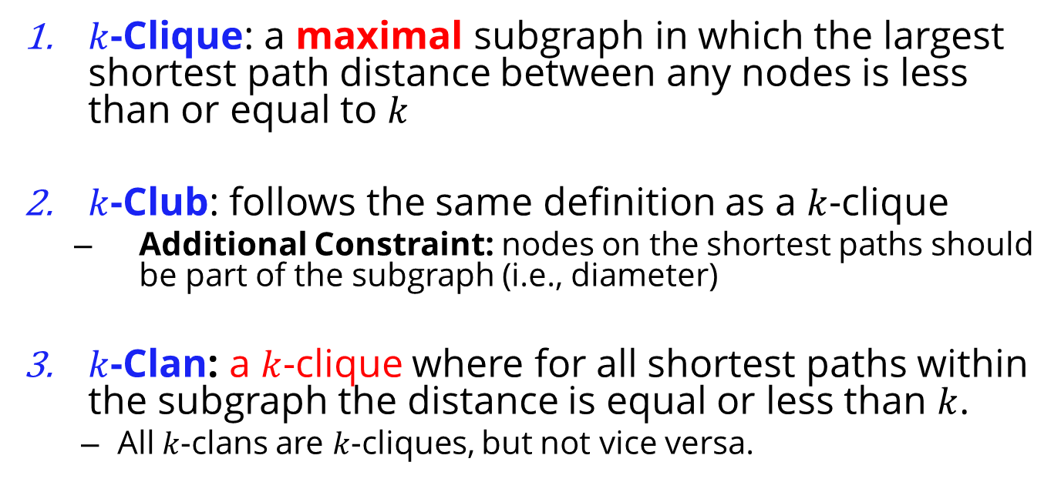
Special Subgraphs
$k$-Clique: a maximal subgraph in which the largest shortest path distance between any nodes is less than or equal to $k$
$k$-Club: follows the same definition as a $k$-clique
Additional Constraint: nodes on the shortest paths should be part of the subgraph (i.e., diameter)
$k$-Clan: a $k$-clique where for all shortest paths within the subgraph the distance is equal or less than $k$.
All $k$-clans are $k$-cliques, but not vice versa.

Slide 30
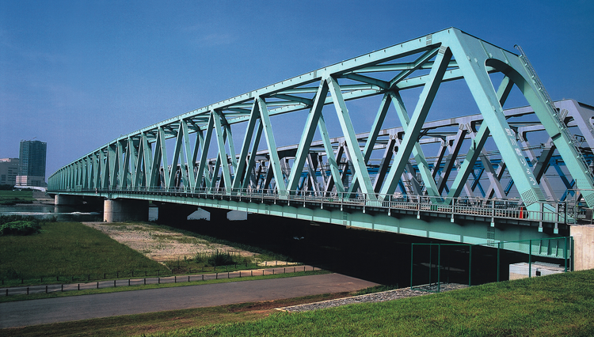
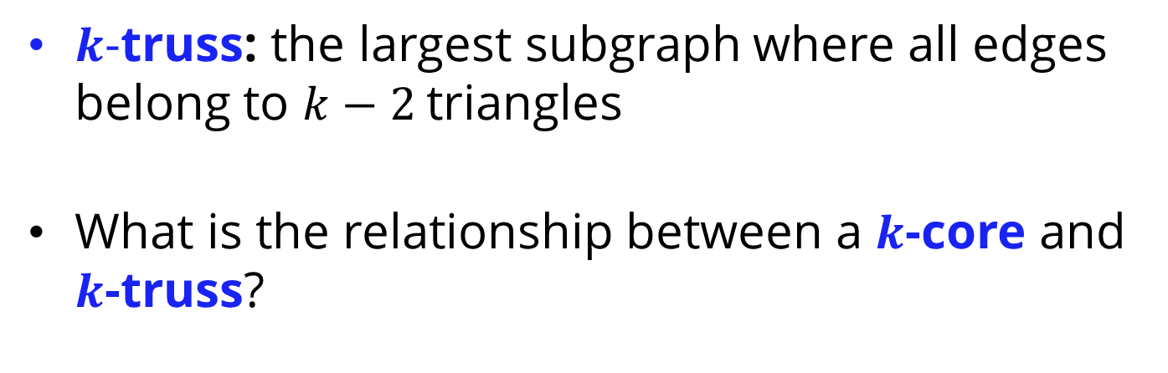
More Special Subgraphs!
$k$-truss: the largest subgraph where all edges belong to $k−2$triangles
What is the relationship between a $k$-core and $k$-truss?

Slide 31
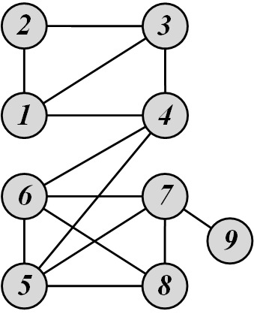
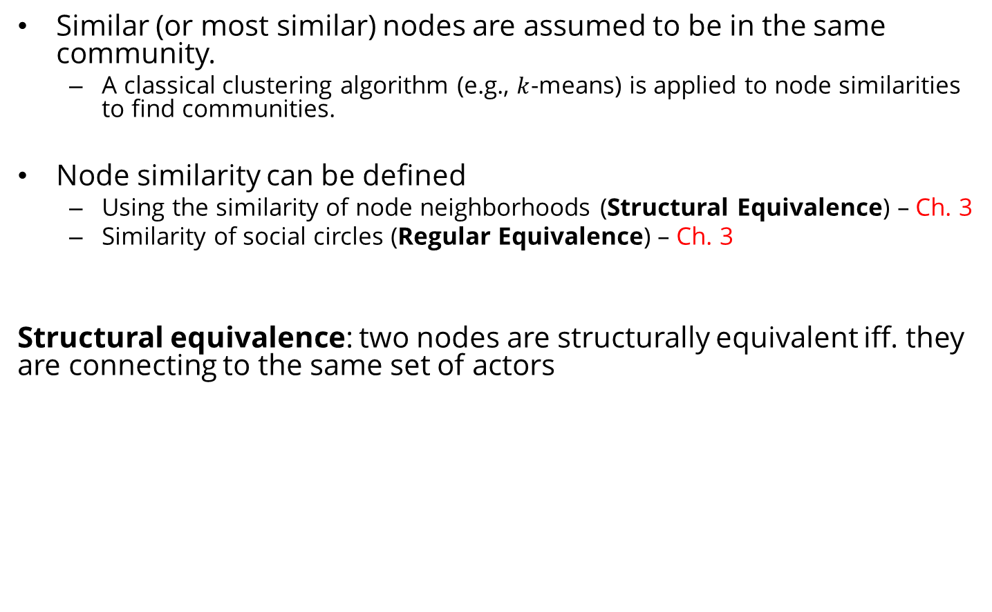
C. Node Similarity
Similar (or most similar) nodes are assumed to be in the same community.
A classical clustering algorithm (e.g., $k$-means) is applied to node similarities to find communities.
Node similarity can be defined
Using the similarity of node neighborhoods (Structural Equivalence) – Ch. 3
Similarity of social circles (Regular Equivalence) – Ch. 3
Structural equivalence: two nodes are structurally equivalent iff. they are connecting to the same set of actors
Nodes 1 and 3 are structurally equivalent,
So are nodes 5 and 7.

Slide 32
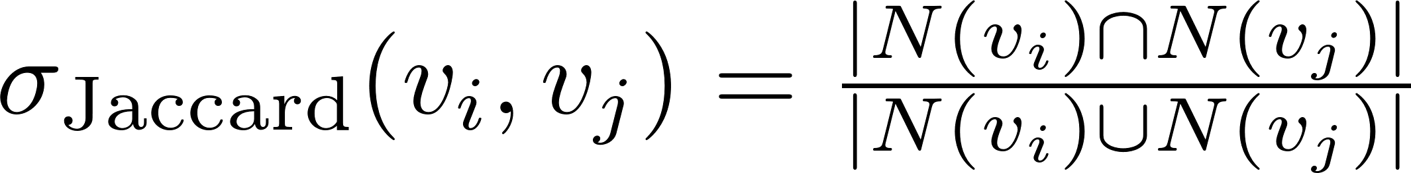
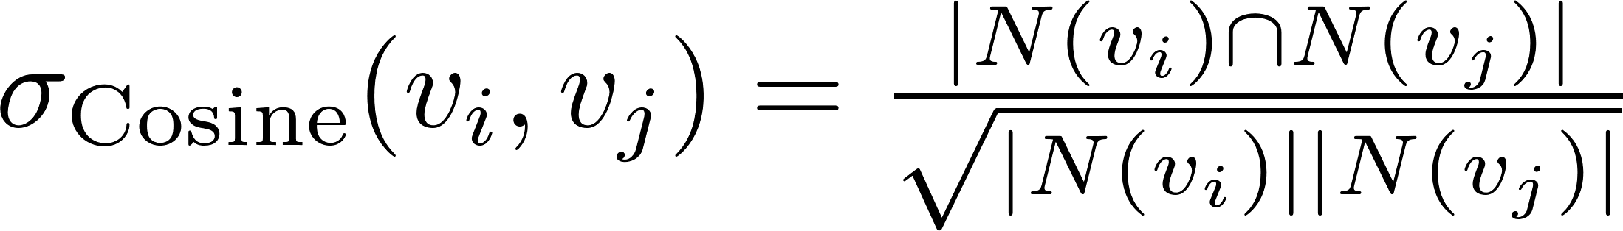
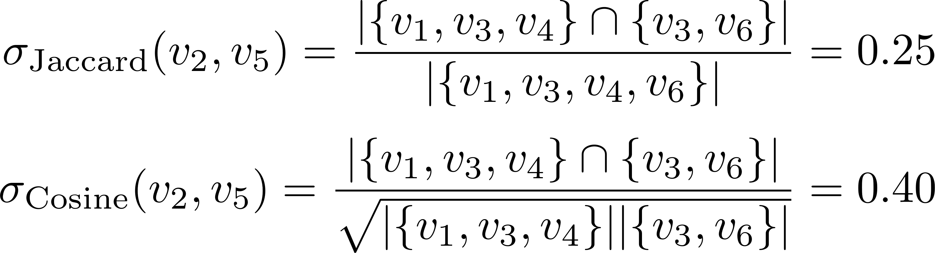
Node Similarity (Structural Equivalence)
Jaccard Similarity
Cosine similarity
Notes:
A is an adjacency matrix

Slide 33
Group-Based Community Detection

Slide 34
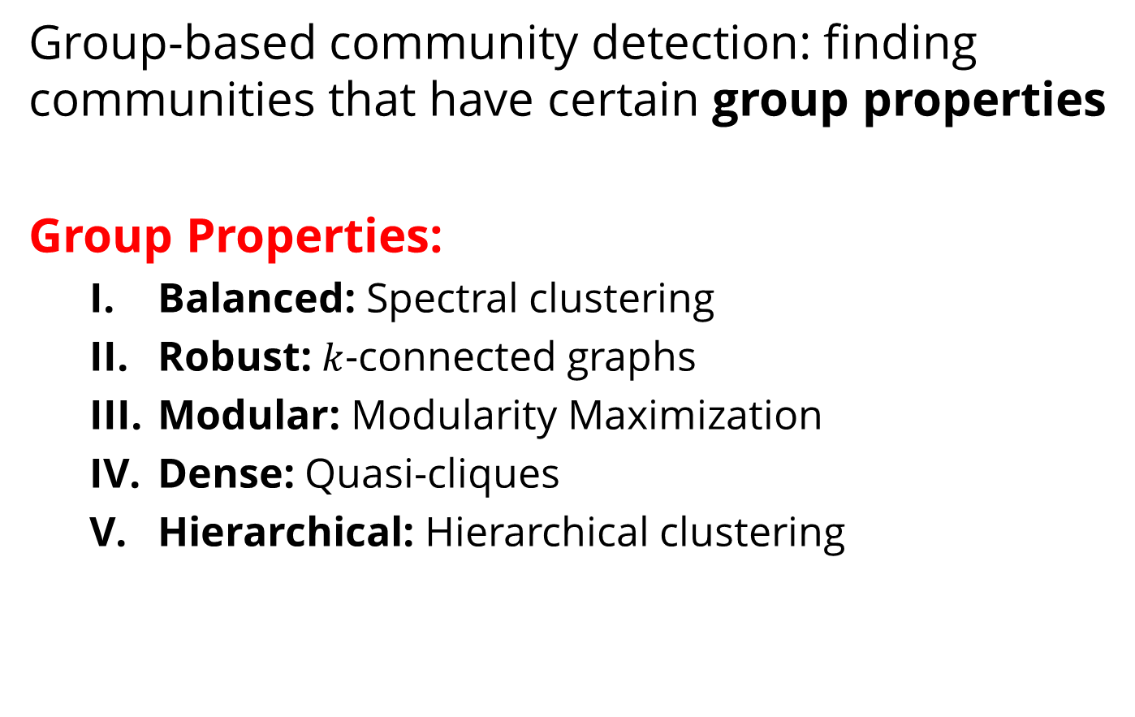
Group-Based Community Detection
Group-based community detection: finding communities that have certain group properties
Group Properties:
Balanced: Spectral clustering
Robust: $k$-connected graphs
Modular: Modularity Maximization
Dense: Quasi-cliques
Hierarchical: Hierarchical clustering

Slide 35
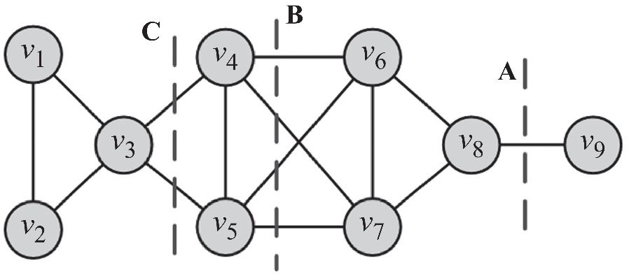
I. Balanced Communities
Community detection can be thought of graph clustering
Graph clustering: we cut the graph into several partitions and assume these partitions represent communities
Cut: partitioning (cut) of the graph into two (or more) sets (cutsets)
The size of the cut is the number of edges that are being cut
Minimum cut (min-cut) problem: find a graph partition such that the number of edges between the two sets is minimized
Min-cut
Min-cuts can be computed efficiently using the max-flow min-cut theorem
Min-cut often returns an imbalanced partition, with one set being a singleton

Slide 36
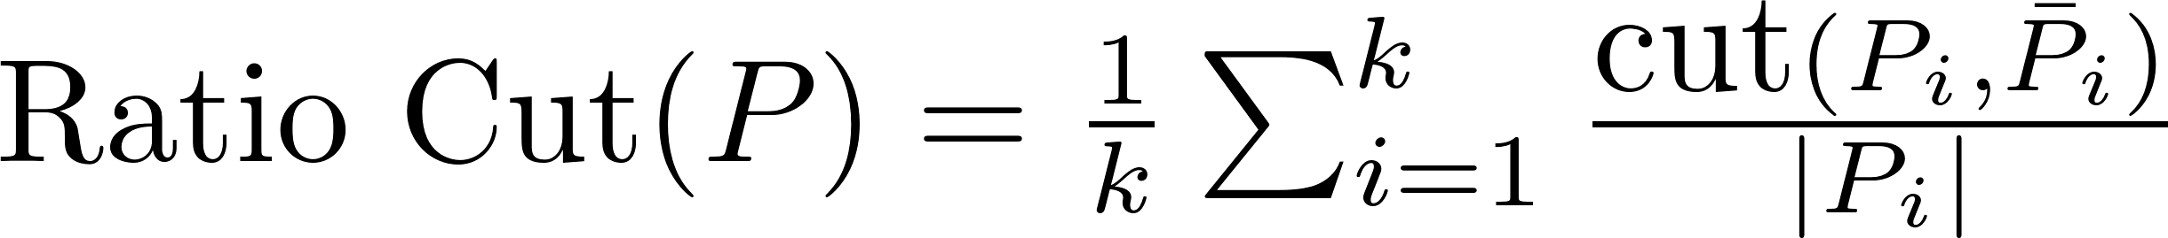
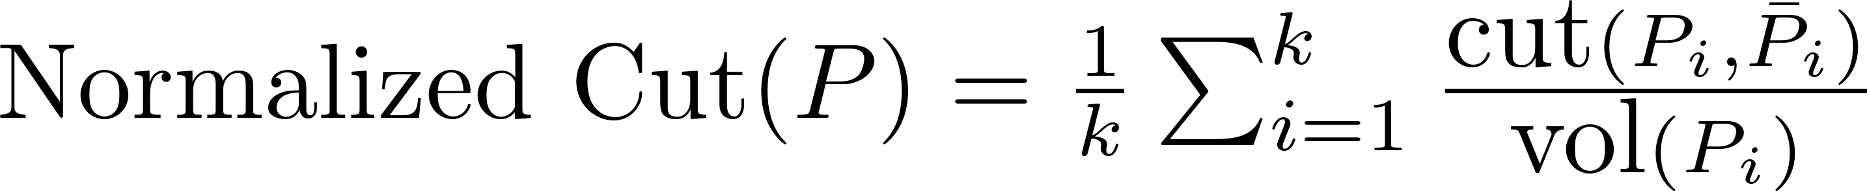
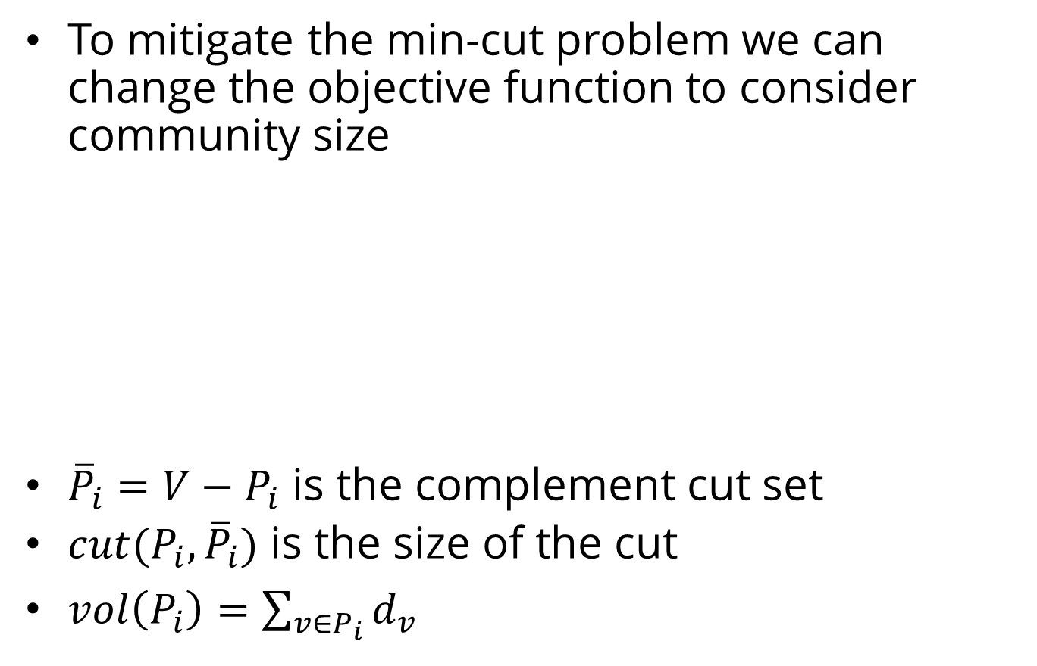
Ratio Cut and Normalized Cut
To mitigate the min-cut problem we can change the objective function to consider community size
${\overline{P}}_{i}=V−P_{i}$ is the complement cut set
$cut({P_{i},\overline{P}}_{i})$ is the size of the cut
$vol\left(P_{i}\right)=\sum_{{v∈P}_{i}}{d_{v}}$

Slide 37
Ratio Cut & Normalized Cut: Example
B
A
For Cut A
For Cut B
Both ratio cut and normalized cut prefer a balanced partition
Notes:
From Lei’s slides must be changed

Slide 38
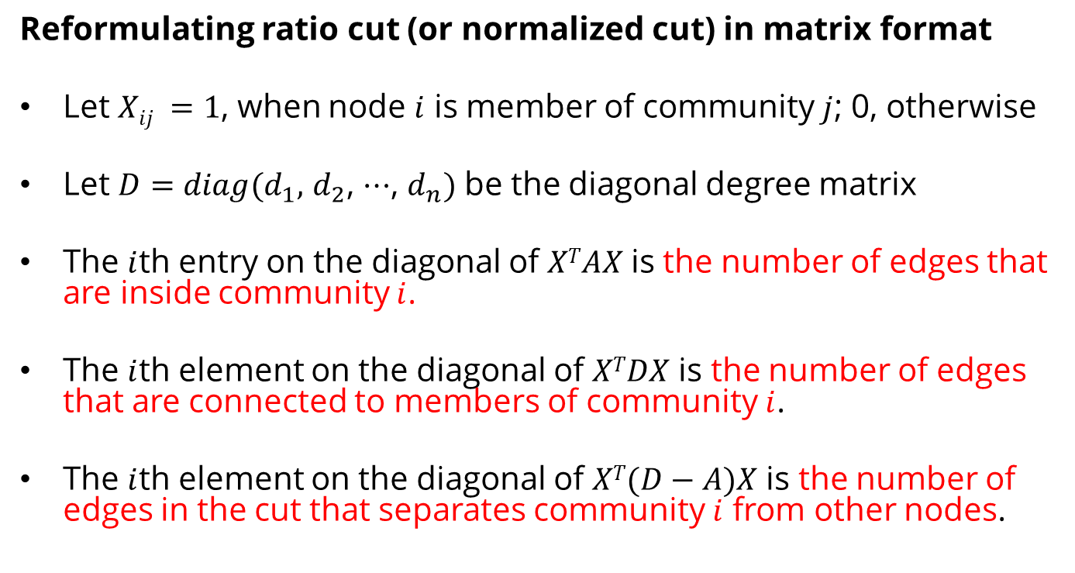
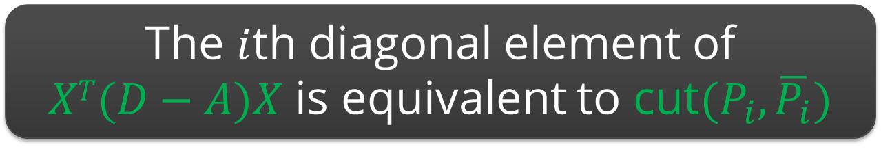
Spectral Clustering
Reformulating ratio cut (or normalized cut) in matrix format
Let $Xij =1$, when node $i$ is member of community $j$; 0, otherwise
Let $D=diag(d_{1},$ $d_{2}$, $⋯$, $d_{n})$ be the diagonal degree matrix
The $i$th entry on the diagonal of $XTAX$ is the number of edges that are inside community $i$.
The $i$th element on the diagonal of $XTDX$ is the number of edges that are connected to members of community $i$.
The $i$th element on the diagonal of $XT(D−A)X$ is the number of edges in the cut that separates community $i$ from other nodes.
The $i$th diagonal element of
$XT(D−A)X$ is equivalent to cut$(P_{i},\overline{P_{i}})$

Slide 39
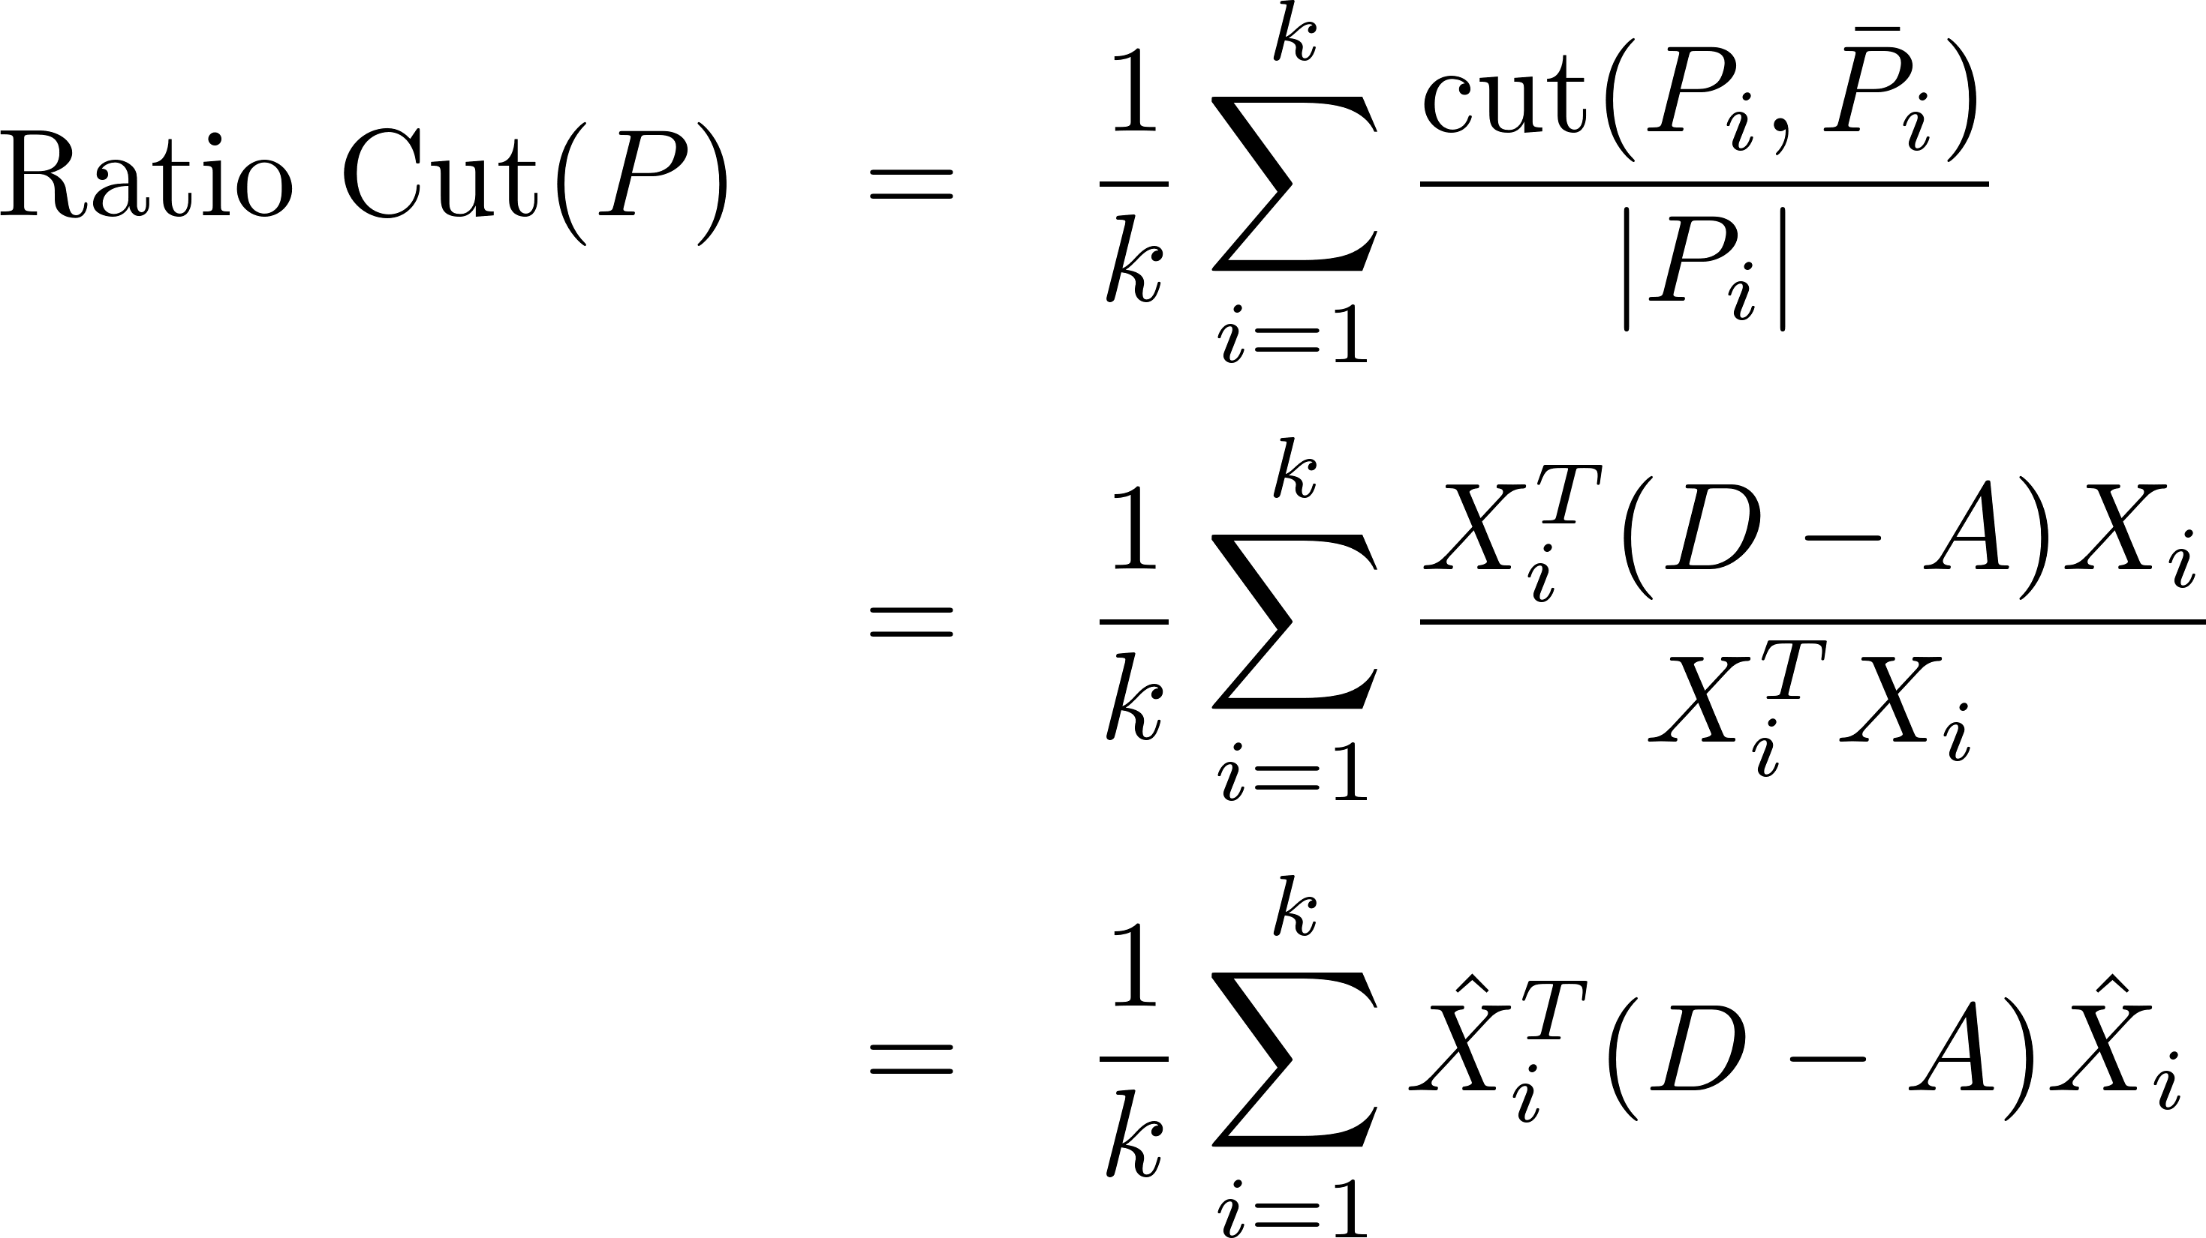
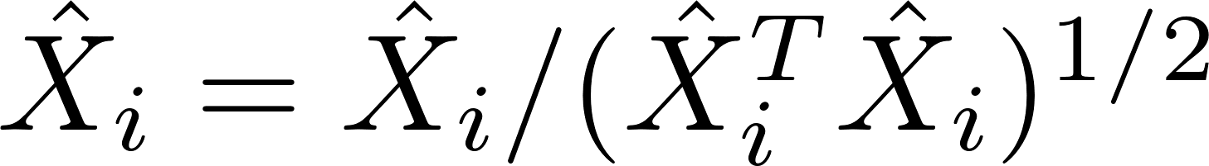
Spectral Clustering
So ratio cut is

Slide 40
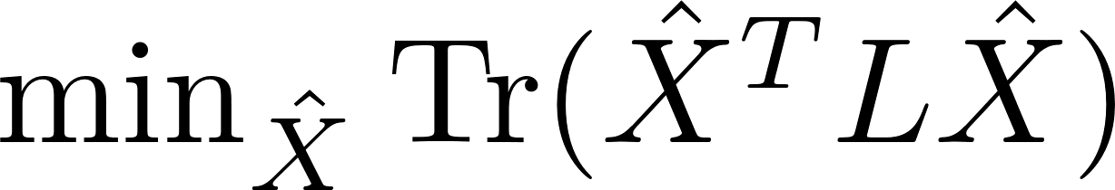


Spectral Clustering
Both ratio/normalized cut can be reformulated as
Spectral relaxation:
$D=diag(d_{1},$ $d_{2}$, $⋯$, $d_{n})$ is a diagonal degree matrix
Optimal Solution
$\hat{X}$ is the top eigenvectors with the smallest eigenvalues

Slide 41

Recovering Integer Membership Values
Because we performed spectral relaxation, the matrix obtained is not integer valued
To recover $X$ from $\hat{X}$ we can run $k$-means on $\hat{X}$

Slide 42






Spectral Clustering: Example
Two communities:
$$\{v_{1},v_{2},v_{3}\}$$
$$\{v_{4},v_{5},v_{6},v_{7},v_{8},v_{9}\}$$
$$D = diag(2, 2, 4, 4, 4, 4, 4, 3, 1)$$
$k$-means, $k=2$
2 Eigenvectors
i.e., we want
2 communities
Notes:
The 1st eigenvector is discarded

Slide 43


More on Laplacian
Laplacian and Diffusion:
Consider a substance that diffuses from node to node on a graph (e.g., gas or fluid)
The substance quantity for node $j$ is $φ\left(j\right)$
The diffusion depends on the difference in quantity between nodes
e.g., gas pressure difference
Then we have

Slide 44








Laplacian and Diffusion
Why do we call it the Laplacian? As this is equivalent to heat equation
($\frac{dφ}{dt}+α∇^{2}φ=0$) and $L$ replaces the Laplace operator $∇^{2}$

Slide 45





Laplacian and Diffusion
State $φ(t)$ in terms of eigenvalue-eigenvectors of $L$
L is symmetric and has real eigenvalues.
Some coefficient!
Eigenvalues are orthogonal, so right multiply by any $v_{j}$

Slide 46

II. Robust Communities
The goal is find subgraphs robust enough such that removing some edges or vertices does not disconnect the subgraph
$k$-vertex connected ($k$-connected) graph:
$k$ is the minimum number of nodes that must be removed to disconnect the graph
$k$-edge connected: at least $k$ edges must be removed to disconnect the graph
Examples:
Complete graph of size $n$: unique $n$-connected graph
A cycle: $2$-connected graph

Slide 47


III. Modular Communities
Consider a graph $G(V, E)$, where the degrees are known beforehand however edges are not
Consider two vertices $vi$ and $vj$ with degrees $di$ and $dj$.
What is an expected number of edges between $vi$ and $vj$?
For any edge going out of $vi$ randomly the probability of this edge getting connected to vertex $vj$ is

Slide 48
Modularity and Modularity Maximization
Given a degree distribution, we know the expected number of edges between any pairs of vertices
We assume that real-world networks should be far from random. Therefore, the more distant they are from this randomly generated network, the more structural they are.
Modularity defines this distance and modularity maximization tries to maximize this distance

Slide 49





Normalized Modularity
Consider a partitioning of the data $P = (P1, P2, P3, …, Pk)$
For partition $P_{x}$, this distance can be defined as
This distance can be generalized for a partitioning $P$
The normalized version of this distance is defined as Modularity

Slide 50




Modularity Maximization
Modularity matrix
$d∈ℝ^{n×1}$is the degree vector for all nodes
Reformulation of the modularity
$X∈ℝ^{n×k}$is the indicator (partition membership) function:
$X_{ij}=1$ iff. $v_{i}∈P_{j}$
Similar to Spectral clustering,
We relax $X$ to be orthogonal, i.e., matrix $\hat{X}$
The optimal solution for $\hat{X}$ is the top $k$ eigenvectors of $B$.
To recover the original $X$, we can run $k$-means on $\hat{X}$
Difference: in Modularity, the top $k$ eigenvalues have to be positive!

Slide 51





Modularity Maximization: Example
Two
Communities:
{1, 2, 3, 4}
and
{5, 6, 7, 8, 9}
$k$-means
2 eigenvectors
Modularity Matrix
Notes:
From Lei Tang’s Book and Slides

Slide 52

Making Modularity Optimization Faster
The matrix method discussed is slow and does not scale to millions of nodes (and billions of edges)
We can perform greedy optimization of modularity to speed-up the process
Louvain Method
A greedy modularity optimization method for community detection
Invented when all authors affiliated with Université catholique de Louvain (UCL)

Slide 53
Louvain Method
The algorithm has multiple passes
Each pass has two phases
Modularity Optimization
Community Aggregation
Image from Blondel, Vincent D., Jean-Loup Guillaume, Renaud Lambiotte, and Etienne Lefebvre. "Fast unfolding of communities in large networks." Journal of statistical mechanics: theory and experiment 2008, no. 10 (2008): P10008.

Slide 54

Louvain Method
Start with a weighted network where all nodes are in their own communities (i.e., n communities)
First Phase:
For each node $v_{i}$,
For all neighbors $v_{j}∈N(v_{i})$:
compute the modularity gain if $v_{i}$ is removed from its community and placed in the community of $v_{j}$.
Find the community with the maximum modularity gain
If the maximum gain is positive, remove $v_{i}$ from its community, and place it in that community
If no positive gain, do not change communities
Repeat until no node changes its community

Slide 55

Important Points about Phase I
A point can be considered multiple times
A Local Minima of modularity maximization is achieved in phase I
Phase I is order dependent
The modularity achieved is more or less stable and is less dependent on the initial order
The computation time depends on the initial order.

Slide 56

Louvain Method
Second Phase:
Build a new network
Nodes are communities
Edges are the edges between nodes in the corresponding communities (weights are sum of the weights)
Self-loops represent edges within the community
The algorithm creates hierarchies of communities
It usually ends in less than 10 passes
It is seems to be an $O(n\log{n})$ algorithm

Slide 57







Why is it fast?
Modularity can be restated as
Consider node $i$, in an isolated community, when it moves to community $C$
The gain in modularity can be computed easily
Kronecker delta function
community of node $i$
Edges within $C$
Edges between $i$ and $C$
All edges connected to members of $C$

Slide 58



IV. Dense Communities: γ-dense
The density of a graph defines how close a graph is to a clique
A subgraph $G(V, E)$ is a γ-dense (or quasi-clique) if
A $1$-dense graph is a clique
We can find quasi-cliques using the brute force algorithm discussed previously, but there are more efficient methods.

Slide 59
Finding Maximal γ-dense Quasi-Cliques
We can use a two-step procedure consisting of “local search” and “heuristic pruning”
Local search
Sample a subgraph, and find a maximal γ-dense quasi-clique
A greedy approach is to expand a quasi-clique by all of its high-degree neighbors until the density drops below γ
Heuristic pruning
For a γ-dense quasi-clique of size k, we recursively remove nodes with degree less than γ k and incident edges
We can start from low-degree nodes and recursively remove all nodes with degree less that γ k

Slide 60

V. Hierarchical Communities
Previous methods consider communities at a single level
Communities may have hierarchies.
Each community can have sub/super communities.
Hierarchical clustering deals with this scenario and generates community hierarchies.
Initially $n$ members are considered as either 1 or $n$ communities in hierarchical clustering. These communities are gradually
merged (agglomerative hierarchical clustering) or
split (divisive hierarchical clustering)

Slide 61
Hierarchical Community Detection
Goal: build a hierarchical structure of communities based on network topology
Allow the analysis of a network at different resolutions
Representative approaches:
Divisive Hierarchical Clustering
Agglomerative Hierarchical clustering

Slide 62
Divisive Hierarchical Clustering
Divisive clustering
Partition nodes into several sets
Each set is further divided into smaller ones
Network-centric partition can be applied for the partition
One particular example:
Girvan-Newman Algorithm: recursively remove the “weakest” links within a “community”
Find the edge with the weakest link
Remove the edge and update the corresponding strength of each edge
Recursively apply the above two steps until a network is discomposed into a desired number of connected components.
Each component forms a community

Slide 63
Edge Betweenness
To determine weakest links, the algorithm uses edge betweenness.
Edge betweenness is the number of shortest paths that pass along with the edge
Edge betweenness measures the “bridgeness” of an edge between two communities
The edge with high betweenness tends to be the bridge between two communities.

Slide 64

Edge Betweenness: Example
The edge betweenness of $e(1, 2)$is$6/2 + 1 = 4$, as all the shortest paths from $2$ to $\{4, 5, 6, 7, 8, 9\}$have to either pass $e(1, 2)$ or $e(2, 3)$, and $e(1,2)$ is the shortest path between $1$ and $2$

Slide 65
The Girvan-Newman Algorithm
Calculate edge betweenness for all edges in the graph.
Remove the edge with the highest betweenness.
Recalculate betweenness for all edges affected by the edge removal.
Repeat until all edges are removed.

Slide 66


Edge Betweenness Divisive Clustering: Example
Initial betweenness value
the first edge that needs to be removed is e(4, 5) ( or e(4, 6) )
By removing e(4, 5), we compute the edge betweenness once again; this time, e(4, 6) has the highest betweenness value: 20.
This is because all shortest paths between nodes {1,2,3,4} to nodes {5,6,7,8,9} must pass e(4, 6); therefore, it has betweenness 4$×$5 = 20.

Slide 67

Community Detection Algorithms

Slide 68
Community Evolution

Slide 69
Network and Community Evolution
How does a network change over time?
How does a community change over time?
What properties do you expect to remain roughly constant?
What properties do you expect to change?
For example,
Where do you expect new edges to form?
Which edges do you expect to be dropped?

Slide 70
How Networks Evolve?

Slide 71
Network Growth Patterns
Network Segmentation
Graph Densification
Diameter Shrinkage

Slide 72

1. Network Segmentation
Often, in evolving networks, segmentation takes place, where the large network is decomposed over time into three parts
Giant Component: As network connections stabilize, a giant component of nodes is formed, with a large proportion of network nodes and edges falling into this component.
Stars: These are isolated parts of the network that form star structures. A star is a tree with one internal node and n leaves.
Singletons: These are orphan nodes disconnected from all nodes in the network.

Slide 73


2. Graph Densification
The density of the graph increases as the network grows
The number of edges increases faster than the number of nodes does
Densification exponent: $1 ≤ α ≤ 2$:
$α =1$: linear growth – constant out-degree
$α =2$: quadratic growth – clique
$E(t)$and $V(t)$are numbers of edges and nodes respectively at time $t$

Slide 74


Densification in Real Networks
E(t)
E(t)
1.69
1.66
V(t)
V(t)
Physics Citations
Patent Citations
Notes:
Source: Leskovec et al. KDD 2005

Slide 75


3. Diameter Shrinking
In networks diameter shrinks over time
ArXiv citation graph
Affiliation Network

Slide 76
How Communities Evolve?

Slide 77

Community Evolution
Communities also expand, shrink, or dissolve in dynamic networks

Slide 78
Community Detection in Evolving Networks

Slide 79

Extending Previous Methods
Take t snapshots of the network, $G_{1}$,$G_{2}, ⋯, G_{t}$ where $G_{i}$ is a snapshot at time $i$
Perform a static community detection algorithm (all methods discussed before) on all snapshots independently
Assign community members based on communities found in all $t$ time stamps.
E.g., Assign nodes to communities based on voting (assign nodes to communities they belong to the most over time)
Unstable in highly dynamic networks as community memberships are always changing

Slide 80

Evolutionary Clustering
Assume that communities don’t change most of the time
Minimize an objective function that considers
Snapshot Cost. Communities at different times (SC)
Temporal Cost. How communities evolve (TC)
Objective function is defined as

Slide 81



Evolutionary Clustering
If we use spectral clustering for each snapshot
Then, ${Cost}_{t}$, the objective function at time$t$ is
$X_{t}$ is the community membership matrix at $t$
To define TC we can use
Challenges with this definition
Assumes that we have the same number of communities at time $t−1$ and $t$
$X_{t}$ is non-unique (any orthogonal transformation is still a solution)

Slide 82



Evolutionary Clustering
We can define TC as
Hence cost will be

Slide 83



Evolutionary Clustering
Assuming Normalized Laplacian is used
Similar to Spectral Clustering
$X_{t}$ can be obtained by taking the top eigenvectors of $\hat{L}$

Slide 84
Community Evaluation

Slide 85


Evaluating the Communities
We are given objects of two different kinds ($+$, $×$)
The perfect community: all objects inside the community are of the same type
Evaluation with ground truth
Evaluation without ground truth

Slide 86
Evaluation with Ground Truth
When ground truth is available
We have partial knowledge of what communities should look like
We are given the correct community (clustering) assignments
Measures
Precision and Recall, or F-Measure
Purity
Normalized Mutual Information (NMI)
Notes:
TP – the intersection of the two oval shapes; TN – the rectangle minus the two oval shapes; FP – the circle minus the blue part; FN – the blue oval minus the circle. Accuracy = (TP+TN)/(TP+FP+FN+FN); Precision = TP/(TP+FP); Recall = TP/(TP+FN)

Slide 87




Precision and Recall
$\text{Precision}\text{ =}$ $\frac{\text{Relevant} \text{and} \text{retrieved}}{\text{Retrieved}}$
$\text{Recall}\text{ =}$ $\frac{\text{Relevant} \text{and} \text{retrieved}}{\text{Relevant}}$
True Positive (TP) :
When similar members are assigned to the same communities
A correct decision.
True Negative (TN) :
When dissimilar members are assigned to different communities
A correct decision
False Negative (FN) :
When similar members are assigned to different communities
An incorrect decision
False Positive (FP) :
When dissimilar members are assigned to the same communities
An incorrect decision

Slide 88




Precision and Recall: Example
Notes:
TP+FP = C(6,2) + C(8,2) = 15+28 = 43; FP counts the wrong pairs within each cluster; FN counts the similar pairs but wrongly put into different clusters; TN counts dissimilar pairs in different clusters

Slide 89


F-Measure
Either $P$ or $R$ measures one aspect of the performance,
To integrate them into one measure, we can use the harmonic mean of precision of recall
For the example earlier,
$$F =2×\frac{0.6×0.61}{0.6+0.61}=0.60$$

Slide 90



Purity
We can assume the majority of a community represents the community
We use the label of the majority against the label of each member to evaluate the communities
Purity. The fraction of instances that have labels equal to the community’s majority label
Purity can be easily tampered by
Points being singleton communities (of size 1); or by
Very large communities
$k$: the number of communities
$N$: total number of nodes,
$Lj$: the set of instances with label $j$in all communities
$Ci$: the set of members in community $i$
Notes:
N – the total number of data points.

Slide 91

Mutual Information
Mutual information (MI). The amount of information that two random variables share.
By knowing one of the variables, it measures the amount of uncertainty reduced regarding the others
$L$ and $H$ are labels and found communities;
$nh$ and $nl$ are the number of data points in community $h$ and with label $l$, respectively;
$nh,l$ is the number of nodes in community $h$ and with label $l$; and $n$ is the number of nodes

Slide 92

Normalizing Mutual Information (NMI)
Mutual information (MI) is unbounded
To address this issue, we can normalize MI
How? We know that
$H(.)$is the entropy function

Slide 93


Normalized Mutual Information
Normalized Mutual Information
We can also define it as
Note that $MI<1/2(H(H)+H(L)$

Slide 94


Normalized Mutual Information
where $l$and $h$ are known (with labels) and found communities, respectively
$nh$ and $nl$ are the number of members in the community $h$ and $l$, respectively,
$nh,l$ is the number of members in community $h$ and labeled $l$,
$n$ is the size of the dataset
NMI values close to one indicate high similarity between communities found and labels
Values close to zero indicate high dissimilarity between them

Slide 95



Normalized Mutual Information: Example
Actual Labels (L)
[2,1,1,1,1,1, 2,2,2,2,2,2,1,1]
Found communities (H)
[1,1,1,1,1,1, 2,2,2,2,2,2,2,2]
 | n_{h}
h=1 | 6
h=2 | 8
 | n_{l}
$$l=1$$ | 7
$$l=2$$ | 7
n_{h,l} | $$l=1$$ | $$l=2$$
h=1 | 5 | 1
h=2 | 2 | 6
$$n = 14$$

Slide 96

Evaluation without Ground Truth
Evaluation with Semantics
A simple way of analyzing detected communities is to analyze other attributes (posts, profile information, content generated, etc.) of community members to see if there is a coherency among community members
The coherency is often checked via human subjects.
Or through labor markets: Amazon Mechanical Turk
To help analyze these communities, one can use word frequencies. By generating a list of frequent keywords for each community, human subjects determine whether these keywords represent a coherent topic.
Evaluation Using Clustering Quality Measures
Use clustering quality measures (SSE)
Use more than two community detection algorithms and compare the results and pick the algorithm with better quality measure

